Slide 1
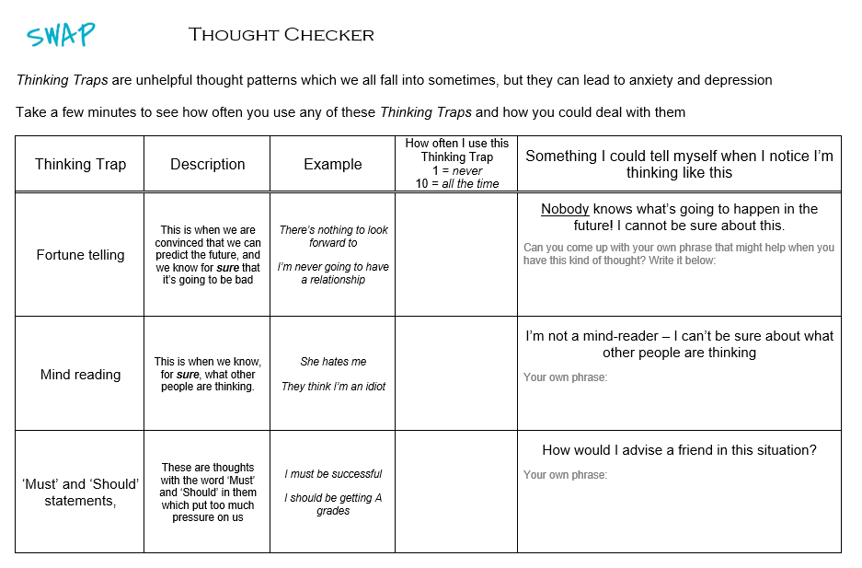
How did it go?

Slide 2
Name your emotions

Slide 3
What are the 6 universal emotions?
HAPPINESS
ANGER
SADNESS
FEAR
DISGUST
SURPRISE

Slide 4

What are the 6 universal emotions?
SURPRISE

Slide 5
If you had never been told about the word ‘sad’ or about the idea of ‘sadness’ would you still be able to feel sad?
Why is it helpful to be able to use the word ‘sad’?
When we tell other people we’re feeling sad, they know what we mean and they know how we’re feeling
We can think about other times we have been sad and remember what helped us feel better

Slide 6

Emotions can be put onto a map!
High
Furious
Excited
Energy
Depressed
Calm
Pleasantness
High
Notes:
Point out that all feelings can be mapped along two dimensions: Energy and Pleasantness. Adapted from: Yale Centre of Emotional Intelligence

Slide 7
Where would you put these on the mood meter?
Angry
Annoyed
Anxious
Balanced
Bored
Calm
Cheerful
Content
Depressed
Desolate
Despairing
Down
Drained
Ecstatic
Elated
Excited
Frustrated
Fuming
Furious
Happy
Hopeless
Hyper
Joyful
Morose
Panicked
Peaceful
Relieved
Restful
Sad
Satisfied
Serene
Sleepy
Stressed
Surprised
Touched
Uneasy

Slide 8
There’s no exact place for each emotion But it should look something like this:
High
Furious | Panicked | Stressed | Hyper | Excited | Ecstatic
Fuming | Angry | Frustrated | Surprised | Happy | Elated
Anxious | Annoyed | Uneasy | Relieved | Cheerful | Joyful
Despairing | Morose | Down | Satisfied | Balanced | Touched
Desolate | Sad | Bored | Restful | Calm | Peaceful
Hopeless | Depressed | Drained | Sleepy | Content | Serene
Energy
High
Pleasantness

Slide 9
Use music

Slide 10
Look at all the things your brain is thinking about when you listen to music!
Memories
Emotions
Connection
Rhythm
Lyrics
Harmony
Timbre
Tempo
Volume
Structure
Melody

Slide 11
Why do you listen to music?
To feel good
To relax or energise
To release bottled-up emotions
To take your mind off bad things
To work out who you want to be
To connect with others
To make sense of current experiences
To remember past experiences

Slide 12

What emotions do you feel?

Slide 13
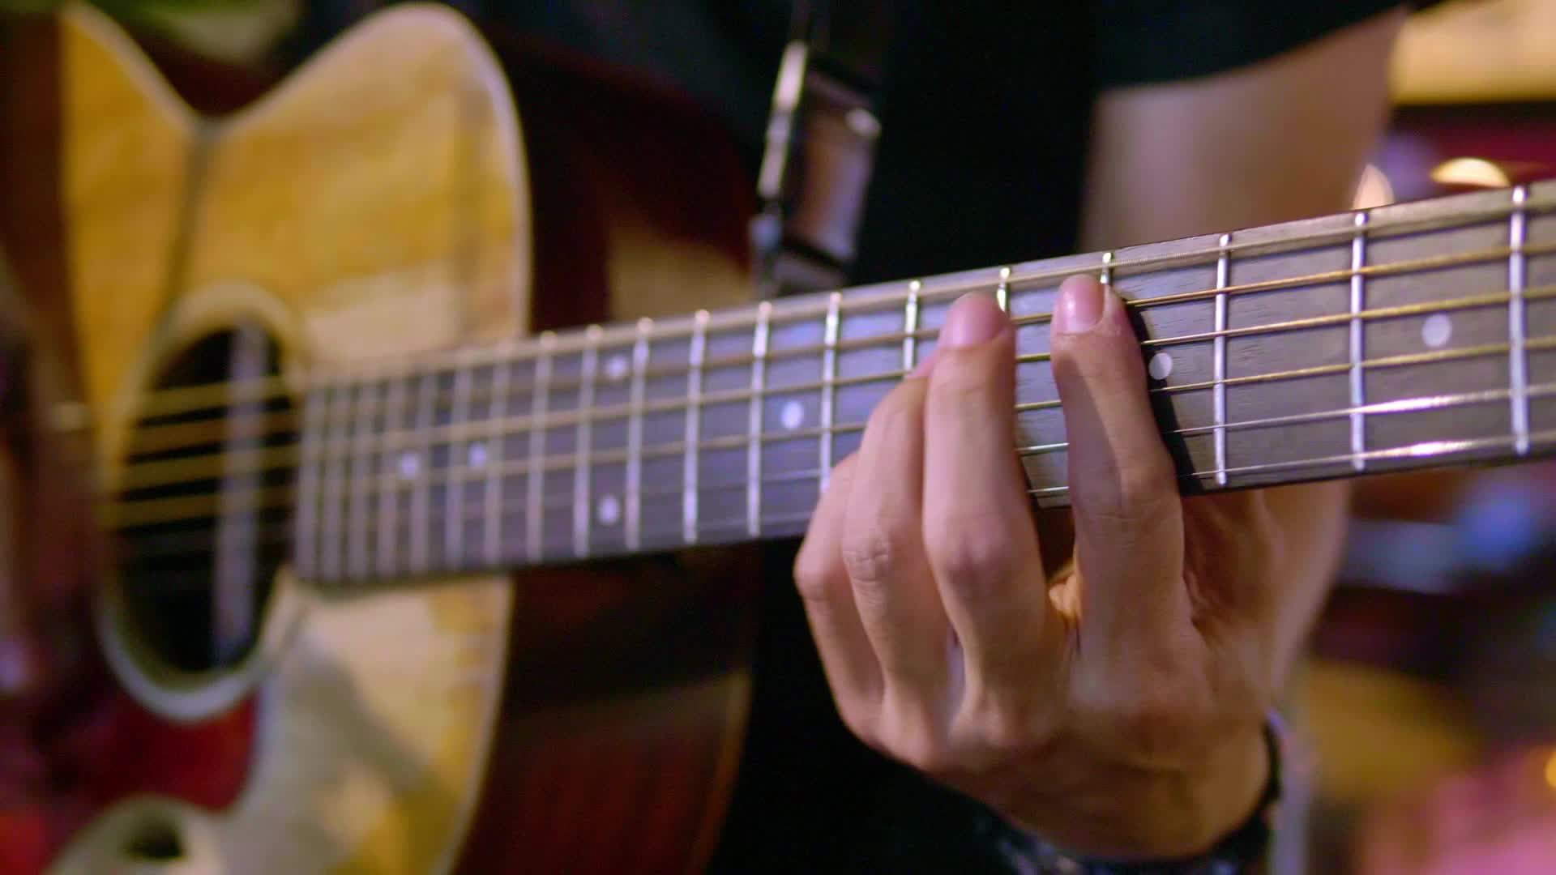
Does the music trigger any memories?

Slide 14

What are your favourite lyrics (words) from any song?

Slide 15

How does it feel when you’re with other people who love the same music as you?

Slide 16
Your perfect wellbeing playlist
Choose 10 tracks:
Name of track
Reason for including it including at least on of these:
Emotion it gives you
Memory it triggers
Bottled-up emotion it helps release
Lyric that helps you to think more clearly about something
Helps you to connect with other people

Slide 17
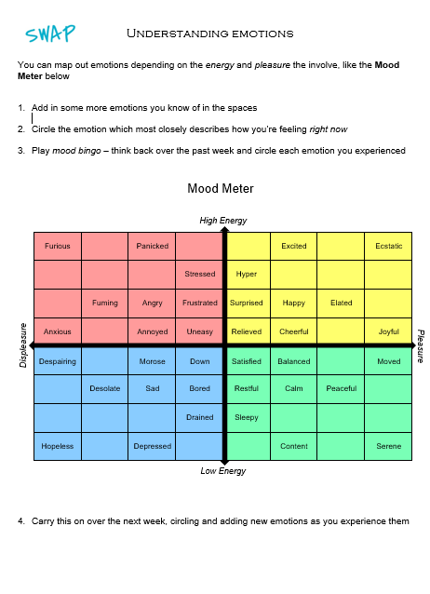
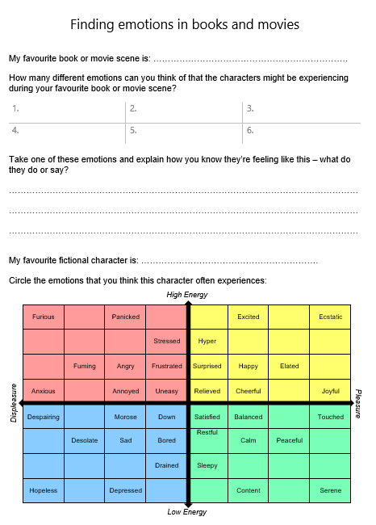
This week’s project!

